Slide 1
بِسْمِ اللهِ الرَّحْمٰنِ الرَّحِيْمِ

Slide 2

Natural Language Processing (NLP)
Lecture 07– Language Models
Instructor:
Dr. Jawad Shafi

Slide 3

Dua – Take Help from Allah Before Starting Any Task
اللَّهُمَّ خِرْ لِيْ وَاخْتَرْ لِي
سُبْحَانَكَ لَا عِلْمَ لَنَا إِلَّا مَا عَلَّمْتَنَا ۖ
إِنَّكَ أَنْتَ الْعَلِيمُ الْحَكِيمُ
رَبِّ اشْرَحْ لِي صَدْرِي
وَيَسِّرْ لِي اَمْرِي
وَاحْلُلْ عُقْدَةً مِنْ لِسَانِي
يَفْقَهُوا قَوْلِي

Slide 4
N-Gram-Language-Models

Slide 5
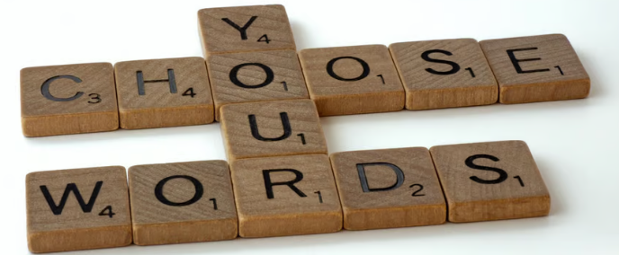
Myth
Outcome

Slide 6
Language Modelling Context
Have you ever guessed what the next sentence in the paragraph you’re reading would likely talk about?
Have you ever noticed that while reading, you almost always know the next word in the sentence?
→ Yes!
Myth
Outcome

Slide 7
Language Modelling Context
In the context of Natural Language Processing, the task of predicting which word comes next is called Language Modeling.
Myth
Outcome

Slide 8
Example - Language Modelling
The students opened their _______.
What are the possible words that we can fill the blank with?
Books📗 📒📚 Notes📖 Laptops👩🏽‍💻 Minds💡🙂 Exams📑❔
Myth
Outcome

Slide 9
Example - Language Modelling
The students opened their _______.
What are the possible words that we can fill the blank with?
Books📗 📒📚 Notes📖 Laptops👩🏽‍💻 Minds💡🙂 Exams📑❔
Myth
Outcome

Slide 10
Example - Language Modelling
Why did we think of these words as the best choices, rather than ‘opened their
doors or windows’?
Myth
Outcome

Slide 11
Example - Language Modelling
We had the words ………, and given the context ‘students’, the words such as books, notes and laptops seem more likely and therefore have a higher probability of occurrence than the words doors and windows.
Myth
Outcome

Slide 12
Probabilities - Language Modelling
Probability is what a language model aims at computing.
N-grams, a very effective and popular traditional NLP technique, widely used before deep learning models became popular.
Myth
Outcome

Slide 13
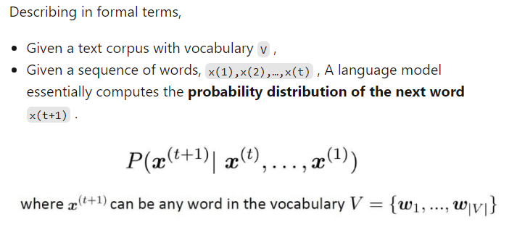
What Does a Language Model Do?
Myth
Outcome

Slide 14
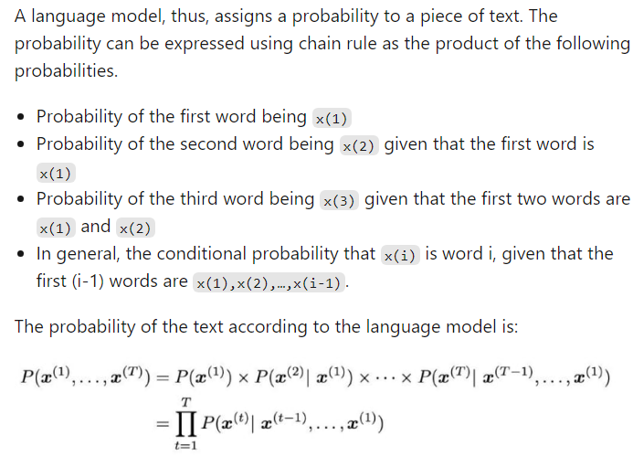
LM – Chain Rule
Myth
Outcome

Slide 15
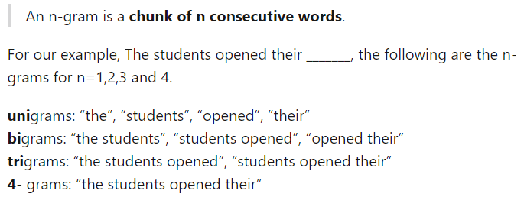
N-Grams!
Myth
Outcome

Slide 16
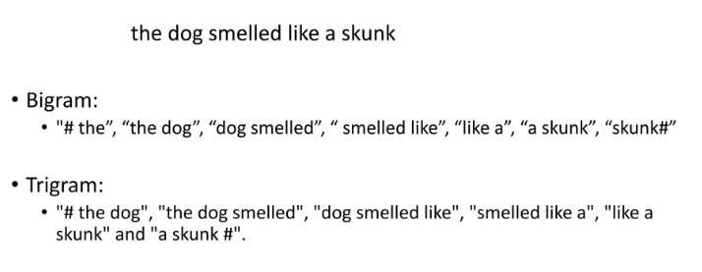
Exemplary Text Generation Using - N-Grams!
Myth
Outcome

Slide 17
LM – N-grams
In an n-gram language model, we make an assumption that the word x(t+1) depends only on the previous (n-1) words. The idea is to collect how frequently the n-grams occur in our corpus and use it to predict the next word.
Myth
Outcome

Slide 18
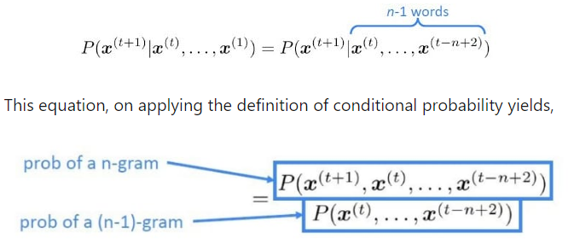
N-Grams! Conti.
Myth
Outcome

Slide 19
How Do We Complete Probabilities in N-Grams!
To compute the probabilities of these n-grams and n-1 grams, we just go ahead and start counting them in a large text corpus!
The Probability of n-gram/Probability of (n-1) gram is given by:
Myth
Outcome

Slide 20
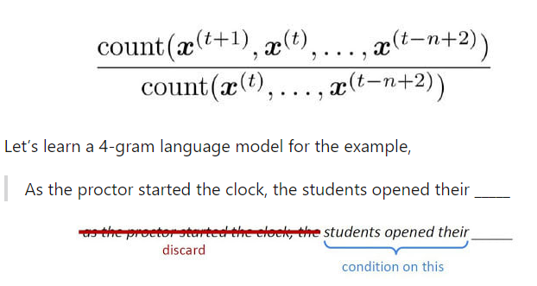
How Do We Complete Probabilities in N-Grams! Conti.
Myth
Outcome

Slide 21
How Do We Complete Probabilities in N-Grams! Conti..
In learning a 4-gram language model, the next word (the word that fills up the blank) depends only on the previous 3 words. If w is the word that goes into the blank, then we compute the conditional probability of the word w as follows:
Myth
Outcome

Slide 22
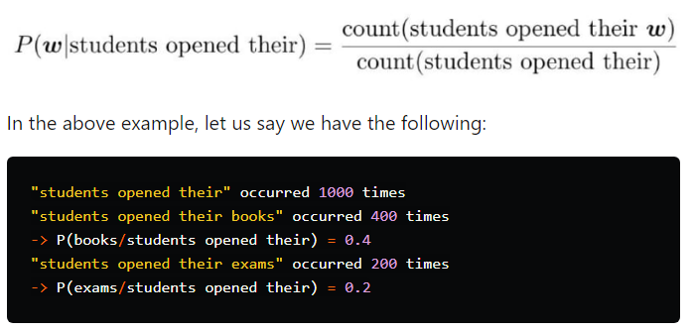
How Do We Complete Probabilities in N-Grams! Conti..
Myth
Outcome

Slide 23
How Do We Complete Probabilities in N-Grams! Conti..
The language model would predict the word books; But given the context, is books really the right choice? Wouldn’t the word exams be a better fit?
As the proctor started the clock, the students opened their-- Should we really have discarded the context ‘proctor’? Looks like we shouldn’t have. This leads us to understand some of the problems associated with n-grams.
Myth
Outcome

Slide 24
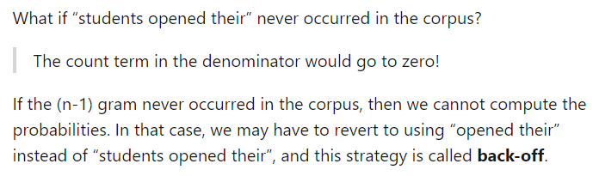
Problems in N-Grams!
Myth
Outcome

Slide 25
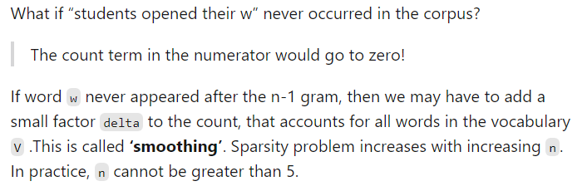
Problems in N-Grams!
Myth
Outcome

Slide 26
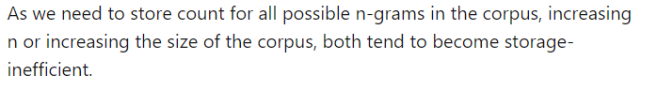
Problems in N-Grams!
Myth
Outcome

Slide 27
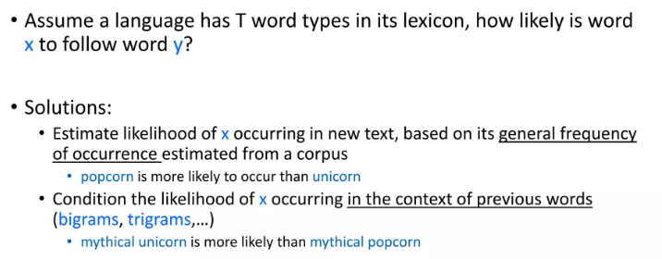
Hidden Markov Model (HMM)
Myth
Outcome

Slide 28
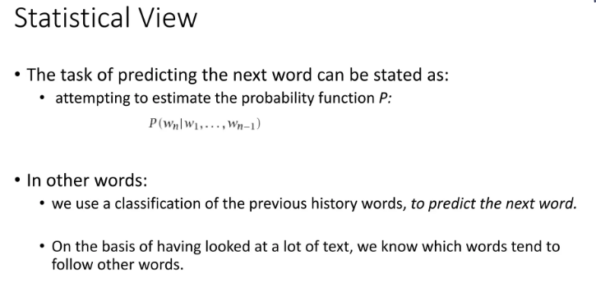
Practical Example of (HMM) in N-Grams!
Myth
Outcome

Slide 29
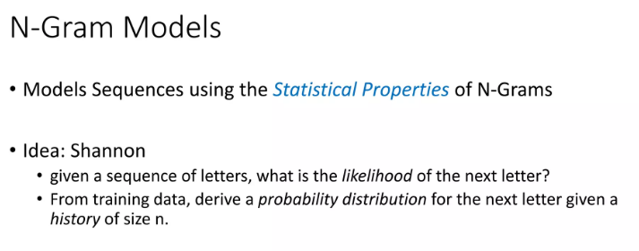
Shannon N-Grams!
Myth
Outcome

Slide 30
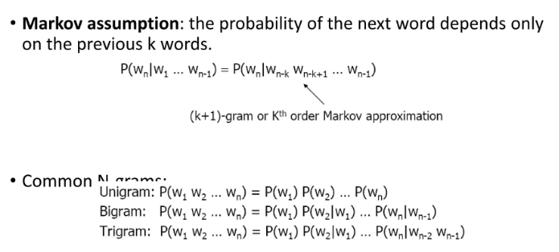
Practical Example of N-Grams!
Myth
Outcome

Slide 31
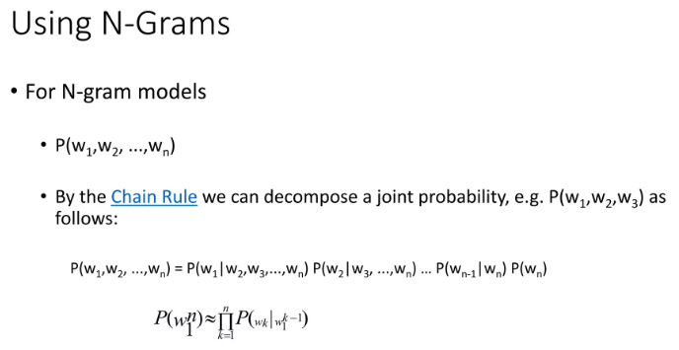
Practical Example of N-Grams!
Myth
Outcome

Slide 32
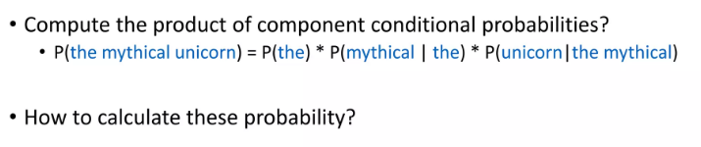
Practical Example of N-Grams!
Myth

Slide 33
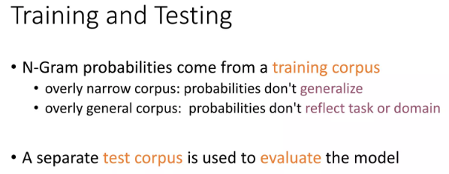
Practical Example of N-Grams!
Myth
Outcome

Slide 34
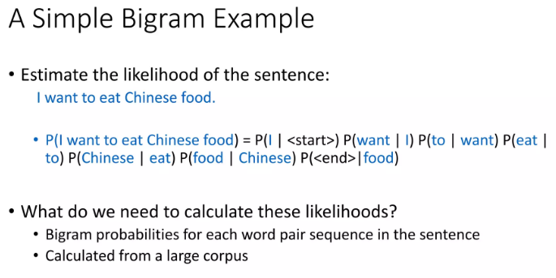
Practical Example of N-Grams!
Myth
Outcome

Slide 35
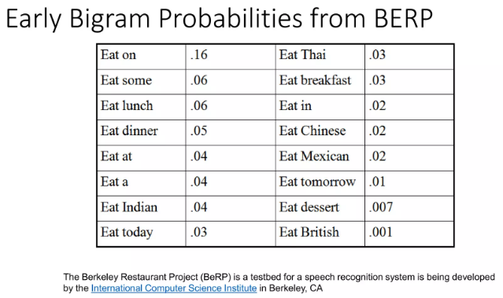
Practical Example of N-Grams!
Myth
Outcome

Slide 36
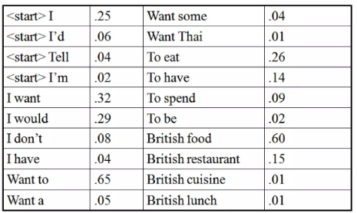
Practical Example of N-Grams!
Myth
Outcome

Slide 37
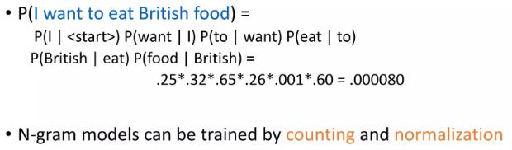
Practical Example of N-Grams!
Myth
Outcome

Slide 38
BoW- LM

Slide 39
Bag of Words (BOW)
Bag of words is a Natural Language Processing technique of text modelling.
Myth
Outcome

Slide 40
Bag of Words (BOW)
A bag of words is a representation of text that describes the occurrence of words within a document.
We just keep track of word counts and disregard the grammatical details and the word order.
It is called a “bag” of words because any information about the order or structure of words in the document is discarded.
The model is only concerned with whether known words occur in the document, not where in the document.
Myth
Outcome

Slide 41
Bag of Words (BOW) – Baseline in NLP
One of the biggest problems with text is that it is messy and unstructured, and machine learning algorithms prefer structured, well defined fixed-length inputs and by using the Bag-of-Words technique we can convert variable-length texts into a fixed-length vector..
Myth
Outcome

Slide 42
Bag of Words (BOW) – Baseline in NLP
At a much granular level, the machine learning models work with numerical data rather than textual data. So to be more specific, by using the bag-of-words (BoW) technique, we convert a text into its equivalent vector of numbers.
Myth
Outcome

Slide 43
Example - Bag of Words (BOW)
Let us see an example of how the bag of words technique converts text into vectors.
Myth
Example(1) without preprocessing:
Sentence 1: ”Welcome to Great Learning, Now start learning”
Sentence 2: “Learning is a good practice”
Outcome

Slide 44
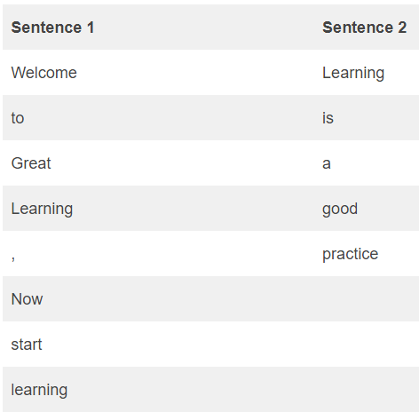
Example - Bag of Words (BOW)
Myth
Outcome

Slide 45
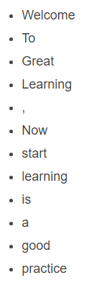
Example - Bag of Words (BOW)
Step 1: Go through all the words in the above text and make a list of all of the words in our model vocabulary.
Myth
Outcome

Slide 46
Example - Bag of Words (BOW)
Note that the words ‘Learning’ and ‘ learning’ are not the same. Also, note that a comma ‘ , ’ is also taken in the list.
Because we know the vocabulary has 12 words, we can use a fixed-length document-representation of 12, with one position in the vector to score each word.
The scoring method we use here is to count the presence of each word and mark 0 for absence. This scoring method is used more generally.
Myth
Outcome

Slide 47
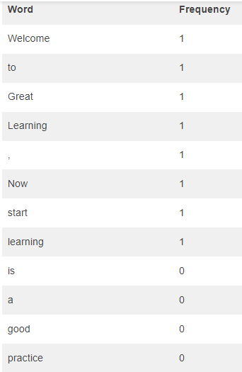
Example - Bag of Words (BOW)
Myth
Outcome

Slide 48
Example - Bag of Words (BOW)
Writing the above frequencies in the vector
Sentence 1 ➝ [ 1,1,1,1,1,1,1,1,0,0,0 ]
Now for sentence 2, the scoring would like
Myth
Outcome

Slide 49
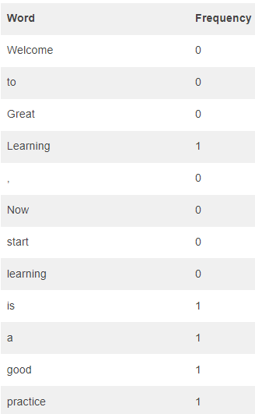
Example - Bag of Words (BOW)
Myth
Outcome

Slide 50
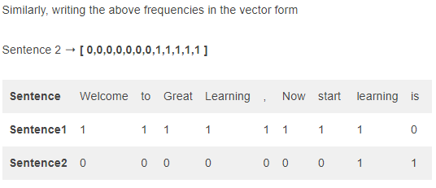
Example - Bag of Words (BOW)
Myth
Outcome

Slide 51
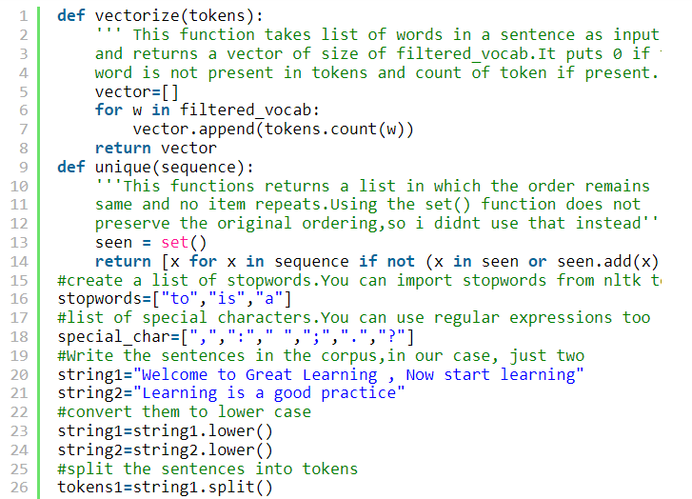
Python - Bag of Words (BOW)
Myth
Outcome

Slide 52
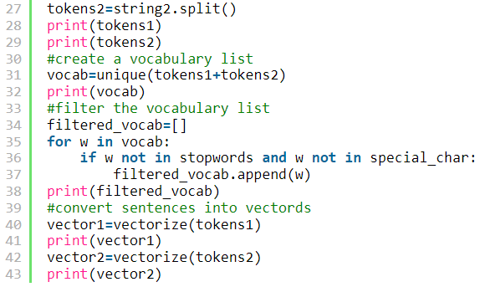
Example - Bag of Words (BOW)
Myth
Outcome

Slide 53
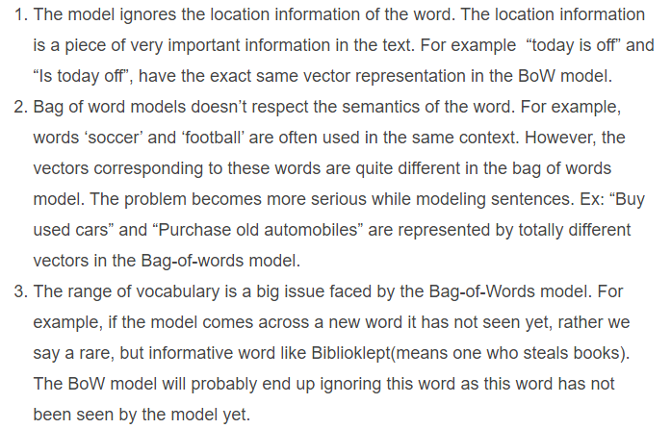
Limitations - Bag of Words (BOW)
Myth
Outcome

Slide 54
TFIDF - LM

Slide 55
TFIDF (term frequency-inverse document frequency)
What does a word having high word count signify?
Does this mean that the word is important in retrieving information about documents? ---→ ????
If a word occurs many times in a document but also along with many other documents in our dataset, maybe it is because this word is just a frequent word; not because it is relevant or meaningful.
Myth
Outcome

Slide 56
TFIDF
One approach is to rescale the frequency of words by how often they appear in all documents so that the scores for frequent words like “the” that are also frequent across all documents are penalized.
This approach is called term frequency-inverse document frequency or shortly known as Tf-Idf approach of scoring.
TF-IDF is intended to reflect how relevant a term is in a given document. So how is Tf-Idf of a document in a dataset calculated?
Myth
Outcome

Slide 57
TFIDF
TF-IDF for a word in a document is calculated by multiplying two different metrics:
The Term Frequency (TF) of a word in a document.
A raw count of instances a word appears in a document.
Myth
Outcome

Slide 58
TFIDF
TF(i,j)=n(i,j)/Σ n(i,j)
Where
n(i,j)= number of times nth word occurred in a document
Σn(i,j)= total number of words in a document
Myth
Outcome

Slide 59
TFIDF
The inverse document frequency(IDF) of the word across a set of documents.
This suggests how common or rare a word is in the entire document set.
The closer it is to 0, the more common is the word. This metric can be calculated by taking the total number of documents, dividing it by the number of documents that contain a word, and calculating the logarithm.
Myth
Outcome

Slide 60
TFIDF
So, if the word is very common and appears in many documents, this number will approach 0. Otherwise, it will approach 1.
Multiplying these two numbers results in the TF-IDF score of a word in a document. The higher the score, the more relevant that word is in that particular document.
To put it in mathematical terms, the TF-IDF score is calculated as follows:
Myth
Outcome

Slide 61
TFIDF
IDF=1+log(N/dN)
Where
N=Total number of documents in the dataset
dN=Total number of documents in which nth word occur
Myth
Outcome

Slide 62
TFIDF
1 added in the above formula is so that terms with zero IDF don’t get suppressed entirely.
This process is known as IDF smoothing.
TF-IDF=TF*IDF
Does this seem too complicated?
Myth
Outcome

Slide 63
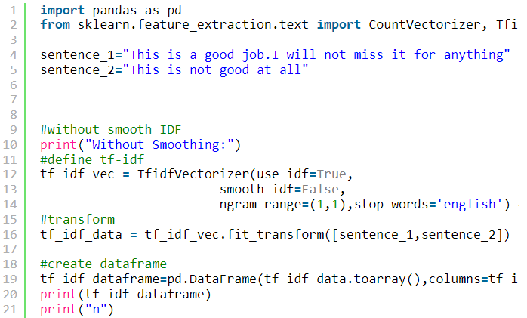
TFIDF
Myth
Outcome

Slide 64
Word Embedding - LM

Slide 65
What does Word Embedding Means
Word embedding is just a fancy way of saying numerical representation of words.
A good analogy would be how we use the RGB representation for colors.
Myth
Outcome

Slide 66
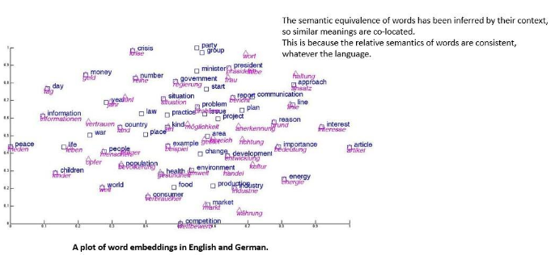
Plotting of Word Embedding
Myth
Outcome

Slide 67
Why we need Word Embedding
Numbers because numbers are used for quantification and why would one need to quantify words?
Speed of my car is 45 km/hr we gain a sense of how fast/slow we are driving. If we say my friend is driving at 60 km/hr, we can compare which one of us is going faster.
Distance of our journey
We use numbers to quantify a quality, when we quote the price of an object we try to quantify its worth, the size of a garment we try to quantify the body proportions it will fit best
Myth
Outcome

Slide 68
Word2Vec — Skip-gram and CBOW
What quality of words do we want to quantify?
We want to quantify the semantics.
We want to represent words in such a manner that it captures its meaning in a way humans do. Not the exact meaning of the word but a contextual one.
For example, when I say the word see, we know exactly what action — the context — I’m talking about, even though we might not be able to quote its meaning, the kind we would find in a dictionary, of the top of our head.
Myth
Outcome

Slide 69
What are good Quality Word Embeddings
The simplest word embedding you can have is using one-hot vectors. If you have 10,000 words in your vocabulary, then you can represent each word as a 1x10,000 vector.
For a simple example, if we have 4 words — mango, strawberry, city, Delhi — in our vocabulary then we can represent them as following:
Mango [1, 0, 0, 0]
Strawberry [0, 1, 0, 0]
City [0, 0, 1, 0]
Delhi [0, 0, 0, 1]
Myth
Outcome

Slide 70
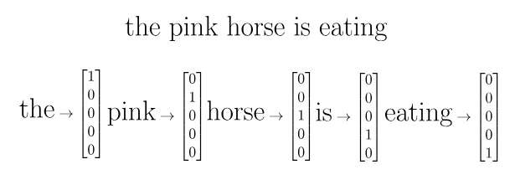
What are good Quality Word Embeddings
Myth
Outcome

Slide 71
What are good Quality Word Embeddings
There are a few problems with the above approach, firstly, our size of vectors depends on the size of our vocabulary (which can be huge).
This is a wastage of space and increases algorithm complexity exponentially resulting in the curse of dimensionality.
Myth
Outcome

Slide 72
What are good Quality Word Embeddings
Secondly, these embedding will be closely coupled to their applications, making transfer-learning to a model using a different vocabulary of the same size, adding/removing words from vocabulary would almost impossible as it would require to re-train the whole model again.
Myth
Outcome

Slide 73
What are good Quality Word Embeddings
Lastly, the entire purpose of creating embedding is to capture the contextual meaning of the words, which this representation fails to do. There is no co-relation between words that have similar meaning or usage.
Myth
Outcome

Slide 74
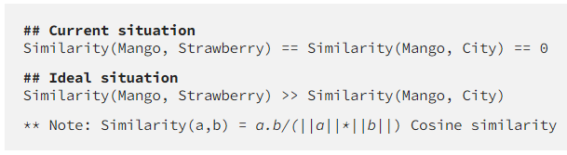
What are good Quality Word Embeddings
Myth
Outcome

Slide 75
Word2Vec — Skip-gram and CBOW
Both are architectures to learn the underlying word representations for each word by using neural networks.
Myth
Outcome

Slide 76
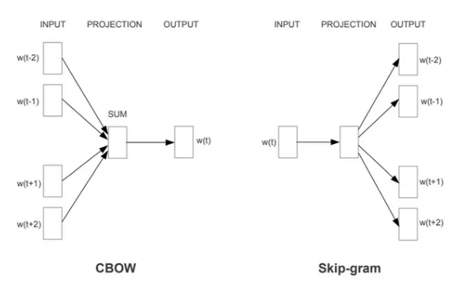
Word2Vec — Skip-gram and CBOW
Myth
Outcome

Slide 77
Word2Vec — Skip-gram and CBOW
In the Continuous Bag of Words Model (CBOW) model, the distributed representations of context (or surrounding words) are combined to predict the word in the middle.
While in the Skip-gram model, the distributed representation of the input word is used to predict the context.
Myth
Outcome

Slide 78
Word2Vec — Skip-gram and CBOW
A prerequisite for any Neural Network (NN) or any supervised training technique is to have labeled training data.
How do you a train a NN model to predict word embedding when you don’t have any labeled data i.e. words and their corresponding word embedding?
Myth
Outcome

Slide 79
Word2Vec — Skip-gram
We’ll do so by creating a “fake” task for the Artificial Neural Network (ANN) to train.
We won’t be interested in the inputs and outputs of this network, rather the goal is actually just to learn the weights of the hidden layer that are actually the “word vectors” that we’re trying to learn.
Myth
Outcome

Slide 80
Word2Vec — Skip-gram
The fake task for Skip-gram model would be,
given a word, we’ll try to predict its neighboring words.
We’ll define a neighboring word by the window size — a hyper-parameter.
Myth
Outcome

Slide 81
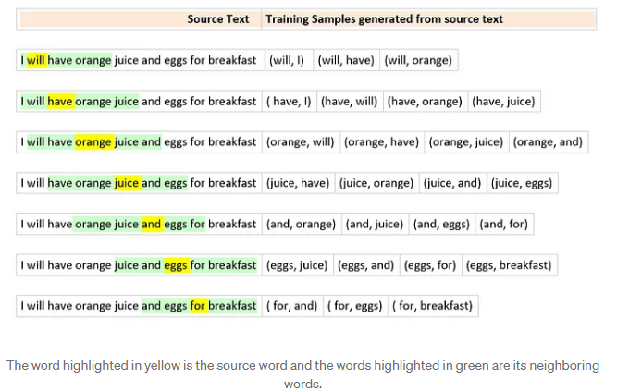
Word2Vec — Skip-gram
Myth
Outcome

Slide 82
Word2Vec — Skip-gram
“I will have orange juice and eggs for breakfast.”
and a window size of 2, if the target word is juice, its neighboring words will be ( have, orange, and, eggs). Our input and target word pair would be (juice, have), (juice, orange), (juice, and), (juice, eggs).
Also note that within the sample window, proximity of the words to the source word plays no role. So have, orange, and, and eggs will be treated the same while training.
Myth
Outcome

Slide 83
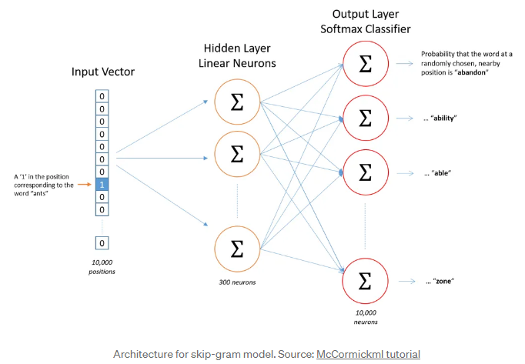
Word2Vec — Skip-gram
Myth
Outcome

Slide 84
Word2Vec — Skip-gram
Both The dimensions of the input vector will be 1xV —
where V is the number of words in the vocabulary — i.e one-hot representation of the word.
The single hidden layer will have dimension VxE,
where E is the size of the word embedding and is a hyper-parameter.
The output from the hidden layer would be of the dimension 1xE, which we will feed into an softmax layer.
Myth
Outcome

Slide 85
Word2Vec — Skip-gram
The dimensions of the output layer will be 1xV,
where each value in the vector will be the probability score of the target word at that position.
According to our earlier example if we have a vector [0.2, 0.1, 0.3, 0.4], the probability of the word being mango is 0.2, strawberry is 0.1, city is 0.3 and Delhi is 0.4.
Myth
Outcome

Slide 86
Word2Vec — Skip-gram
The back propagation for training samples corresponding to a source word is done in one back pass.
So for juice, we will complete the forward pass for all 4 target words ( have, orange, and, eggs).
Myth
Outcome

Slide 87
Word2Vec — Skip-gram
We will then calculate the errors vectors[1xV dimension] corresponding to each target word.
We will now have 4 1xV error vectors and will perform an element-wise sum to get a 1xV vector.
The weights of the hidden layer will be updated based on this cumulative 1xV error vector.
Myth
Outcome

Slide 88
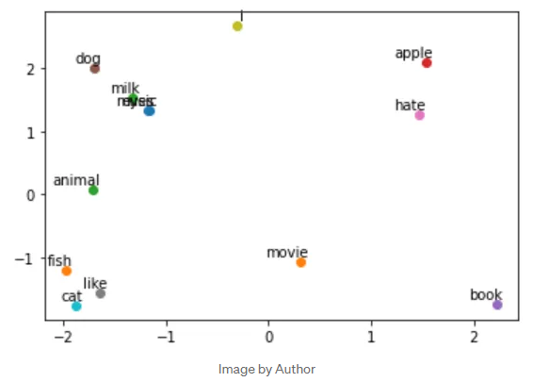
Word2Vec — Skip-gram - Visualization
Myth
Outcome

Slide 89
Word2Vec — CBOW
In CBOW is somewhat similar to Skip-gram, in the sense that we still take a pair of words and teach the model that they co-occur but instead of adding the errors we add the input words for the same target word.
Myth
Outcome

Slide 90
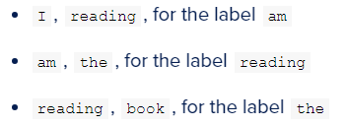
Word2Vec — CBOW
CBOW is a technique where, given the neighboring words, the center word is determined. If our input sentence is “I am reading the book.”, then the input pairs and labels for a window size of 3 would be:
Myth
Outcome

Slide 91
Word2Vec — CBOW
CBOW is a technique where, given the neighboring words, the center word is determined. If our input sentence is “I am reading the book.”, then the input pairs and labels for a window size of 3 would be:
Myth
Outcome

Slide 92
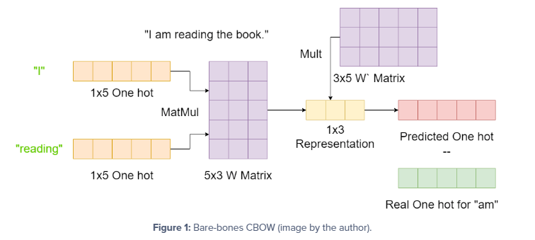
Word2Vec — CBOW
Myth
Outcome

Slide 93
Word2Vec — CBOW
Let’s assume our input sentence in Figure 1 is our complete input text.
That makes our vocabulary size 5, and we will assume there are 3 embedding dimensions for simplicity.
Myth
Outcome

Slide 94
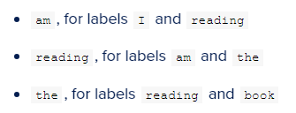
Word2Vec — Skip-Gram
Here, given the center word, we have to predict its neighboring words. :
Myth
Outcome

Slide 95
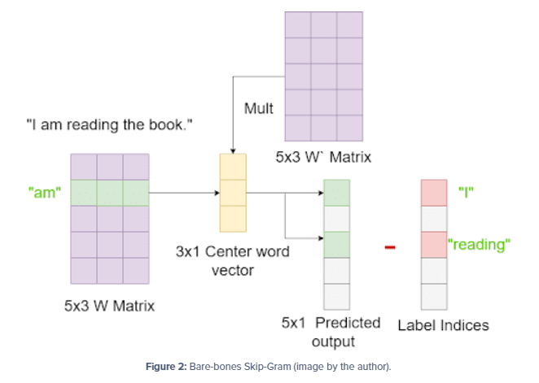
Word2Vec — Skip-Gram
Myth
Outcome

Slide 96
Word2Vec — CBOW
Let’s assume our input sentence in Figure 2 is our complete input text.
That makes our vocabulary size 5, and we will assume there are 3 embedding dimensions for simplicity.
Myth
Outcome

Slide 97
Word2Vec — CBOW
The dimension of our hidden layer and output layer will remain the same.
Only the dimension of our input layer and the calculation of hidden layer activations will change, if we have 4 context words for a single target word, we will have 4 1xV input vectors. Each will be multiplied with the VxE hidden layer returning 1xE vectors. All 4 1xE vectors will be averaged element-wise to obtain the final activation which then will be fed into the softmax layer.
Myth
Outcome

Slide 98
Word2Vec — Skip-gram and CBOW
Skip-gram: works well with a small amount of the training data, represents well even rare words or phrases.
CBOW: several times faster to train than the skip-gram, slightly better accuracy for the frequent words.
Myth
Outcome

Slide 99
Word2Vec — Skip-gram and CBOW
Good tutorial on Skip-gram modelling:
https://mccormickml.com/2016/04/19/word2vec-tutorial-the-skip-gram-model/
Myth
Outcome

Slide 100
LLM

Slide 101
Large Language Model — LLM
Is a LM technique which employe Neural Network (NN) technique with extensive parameters for advanced language processing.
With lots of parameters to process and understand human languages or text using self-supervised learning techniques.
Myth
Outcome

Slide 102
Large Language Model — LLM
LLM is purely based on the deep learning methodologies. LLM (Large language model) models are highly efficient in capturing the complex entity relationships in the text at hand and can generate the text using the semantic and syntactic of that particular language in which we wish to do so.
Myth
Outcome

Slide 103
Generative Pre-trained Transformer
GPT-1 which was released in 2018 contains 117 million parameters having 985 million words.
GPT-2 which was released in 2019 contains 1.5 billion parameters.
GPT-3 which was released in 2020 contains 175 billion parameters. Chat GPT is also based on this model as well.
GPT-4 model is released in the year 2023 and contain trillions of parameters.
Myth
Outcome

Slide 104
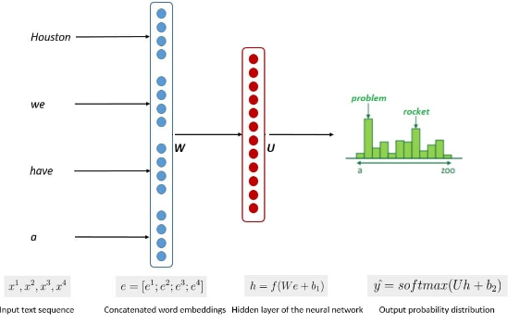
NN— LM
Myth
Outcome

Slide 105
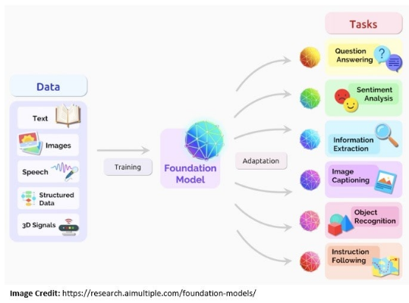
Foundation Model of LLM
Myth
Outcome

Slide 106
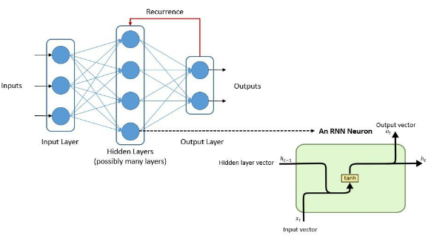
Earlier Architecture of LLM
Myth
Outcome

Slide 107
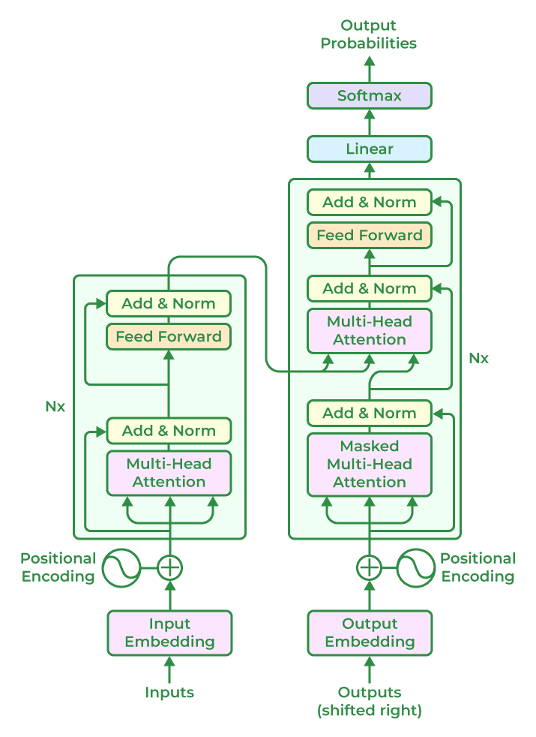
Transformer-Based LLM Model Architectures
Myth
Outcome

Slide 108
Components of Pre-trained Transformer
Input Embeddings: The input text is tokenized into smaller units, such as words or sub-words, and each token is embedded into a continuous vector representation. This embedding step captures the semantic and syntactic information of the input.
Positional Encoding: Positional encoding is added to the input embeddings to provide information about the positions of the tokens because transformers do not naturally encode the order of the tokens. This enables the model to process the tokens while taking their sequential order into account.
Myth
Outcome

Slide 109
Components of Pre-trained Transformer
Encoder: Based on a neural network technique, the encoder analyses the input text and creates a number of hidden states that protect the context and meaning of text data. Multiple encoder layers make up the core of the transformer architecture. Self-attention mechanism and feed-forward neural network are the two fundamental sub-components of each encoder layer.
A. Self-Attention Mechanism: Self-attention enables the model to weigh the importance of different tokens in the input sequence by computing attention scores. It allows the model to consider the dependencies and relationships between different tokens in a context-aware manner.
B. Feed-Forward Neural Network: After the self-attention step, a feed-forward neural network is applied to each token independently. This network includes fully connected layers with non-linear activation functions, allowing the model to capture complex interactions between tokens.
Myth
Outcome

Slide 110
Components of Pre-trained Transformer
Decoder Layers: In some transformer-based models, a decoder component is included in addition to the encoder. The decoder layers enable autoregressive generation, where the model can generate sequential outputs by attending to the previously generated tokens.
Multi-Head Attention: Transformers often employ multi-head attention, where self-attention is performed simultaneously with different learned attention weights. This allows the model to capture different types of relationships and attend to various parts of the input sequence simultaneously.
Myth
Outcome

Slide 111
Components of Pre-trained Transformer
Layer Normalization: Layer normalization is applied after each sub-component or layer in the transformer architecture. It helps stabilize the learning process and improves the model’s ability to generalize across different inputs.
Output Layers: The output layers of the transformer model can vary depending on the specific task. For example, in language modeling, a linear projection followed by SoftMax activation is commonly used to generate the probability distribution over the next token.
Myth
Outcome

Slide 112
LLM Tutorial
Good tutorial LLM-Generative AI can be found at:
https://www.geeksforgeeks.org/large-language-model-llm/
Myth
Outcome

